Slide 1
Sparse spectral methods for
power law equilibrium measures
Timon S. Gutleb¹, Sheehan Olver¹, José A. Carrillo²
¹ Imperial College London
² University of Oxford
Pop-up Numerical Analysis Workshop with Applications in Acoustics
Bickleigh Castle, Devon, 2021

Slide 2
Part I: The motivation

Slide 3
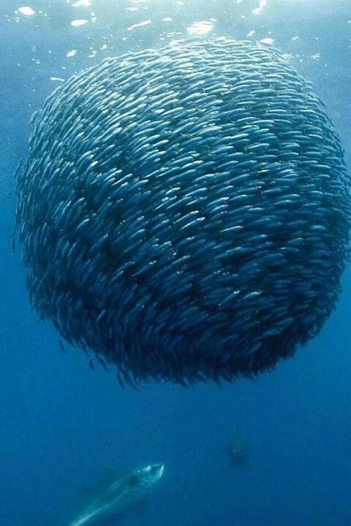
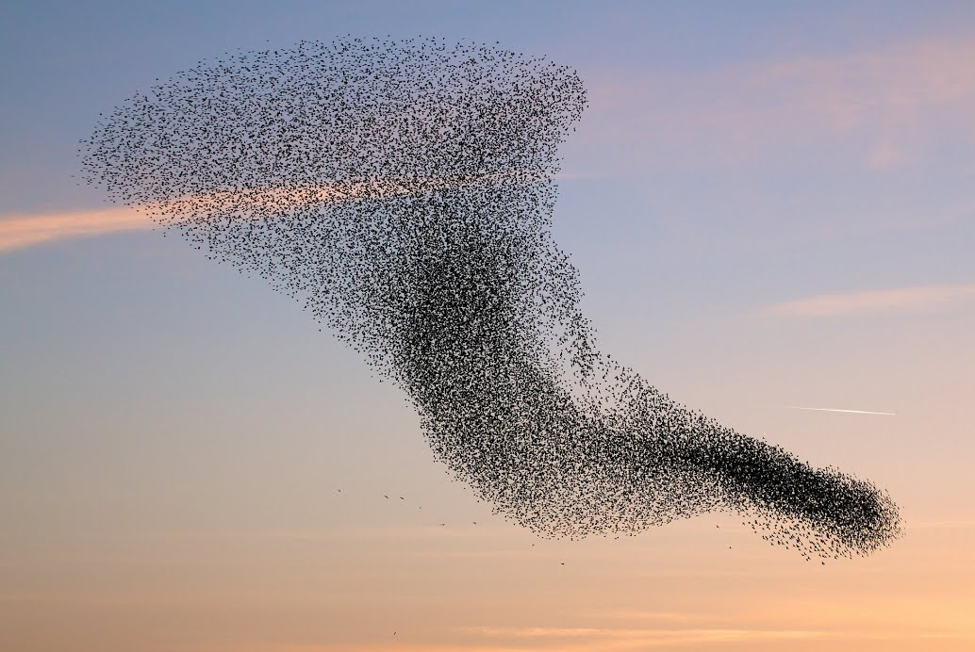
Swarming and collective motion in nature (3D)

Slide 4
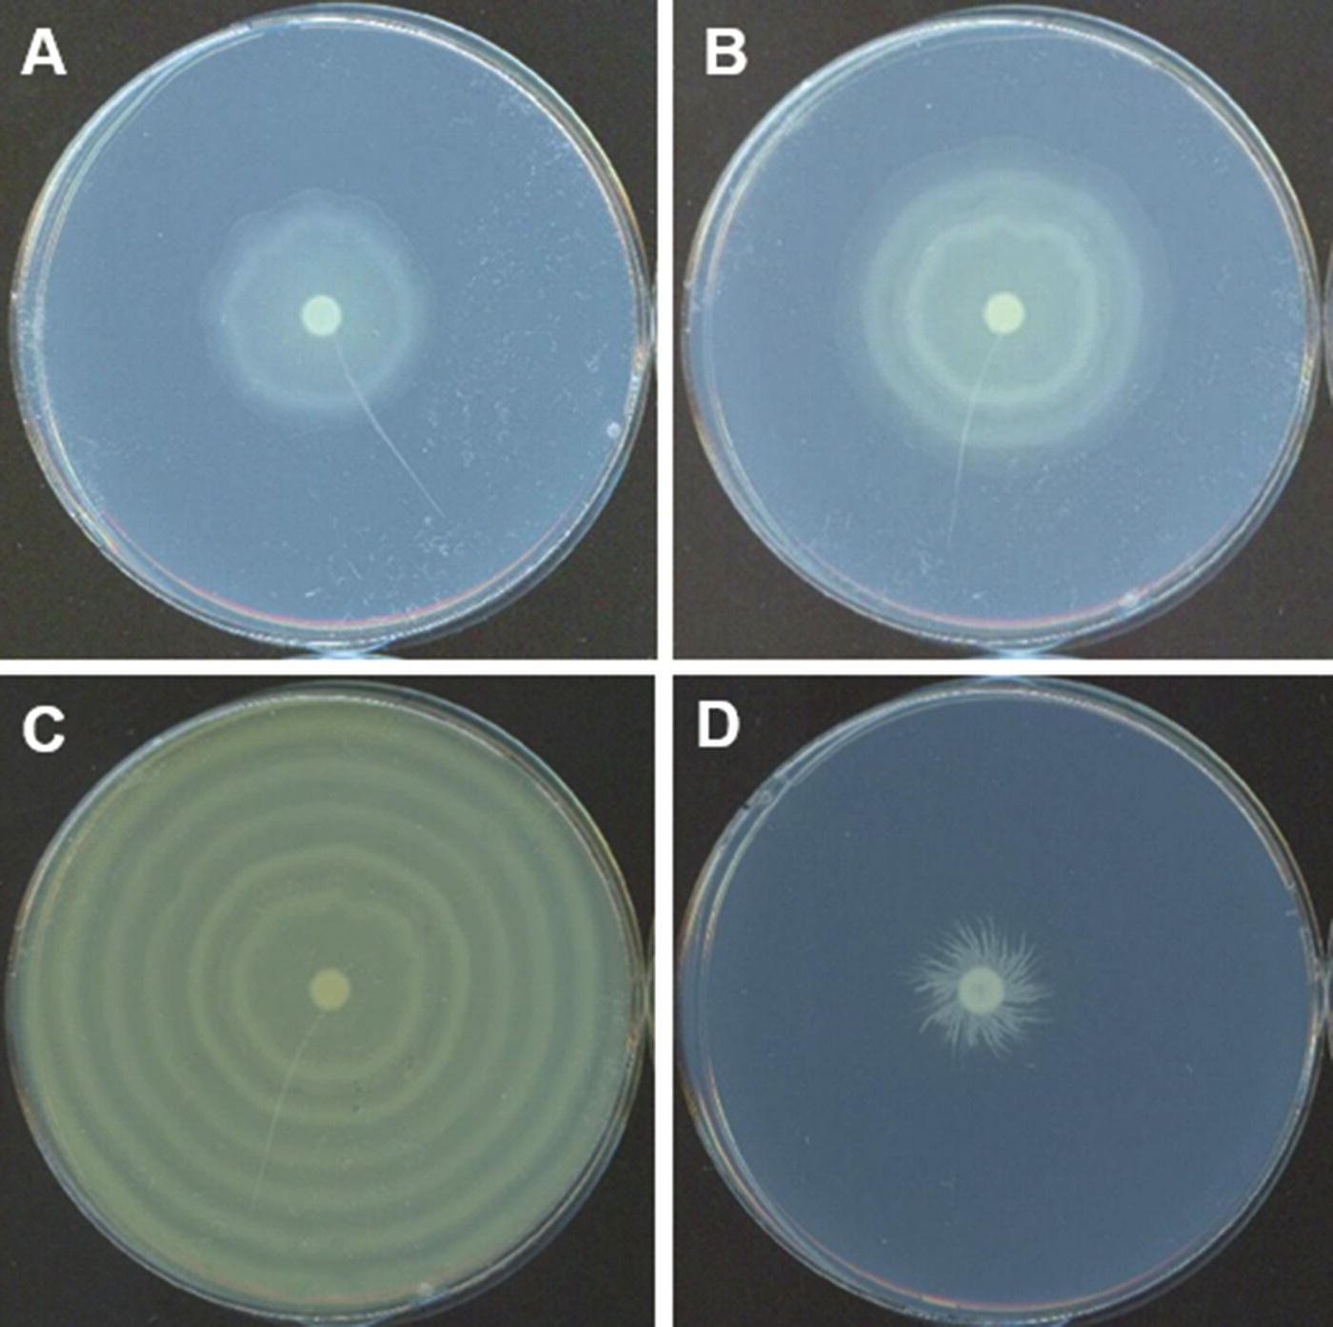
Swarming and collective motion in nature (2D)

Slide 5
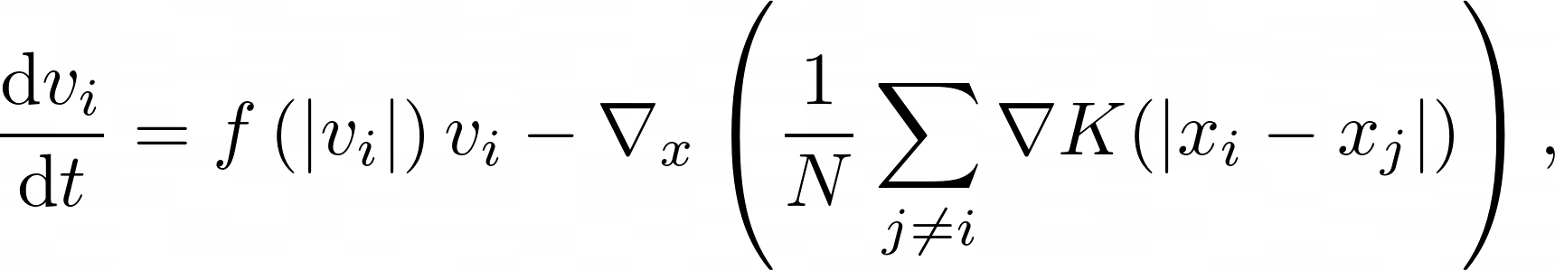
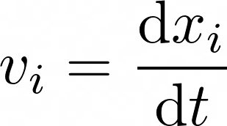
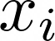
Modeling N-particle interactions
Discrete problem of particle dynamics
velocities:
interaction potential: K
positions:
self-propulsion and friction: f
total particle number: N

Slide 6
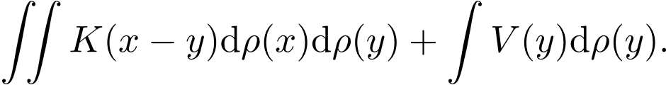
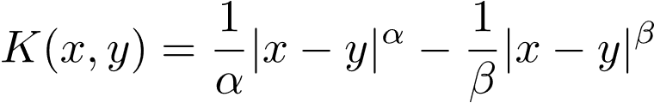
Equilibrium measure problems
We develop a sparse spectral method for equilibrium measure problems, which is to minimize the expression:
In particular, for attraction-repulsion power law kernels
Via an Euler-Lagrange formulation this can be reduced to

Slide 7
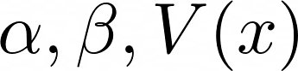
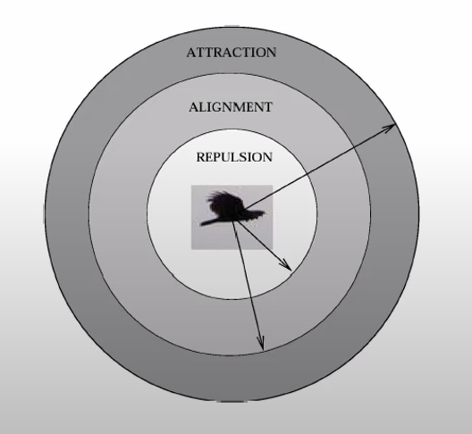
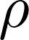
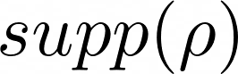
Put plainly
Here’s the equation:
You are given:
You don’t know: E, ,
Task: Find non-negative
such that E is minimized.

Slide 8
Part II: The method

Slide 9
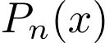
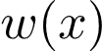
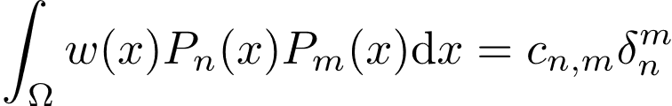
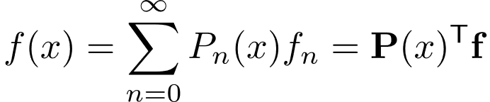
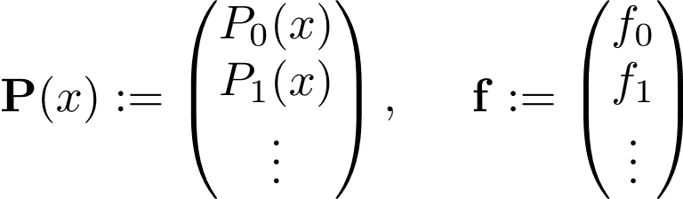
A primer on sparse spectral methods
A set of polynomials is orthogonal w.r.t. a weight if
We can then expand sufficiently well-behaved functions

Slide 10
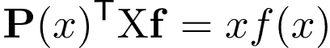
A primer on sparse spectral methods
Multiplication operators can be defined using recurrence relations of the orthogonal polynomial basis of choice
And similarly for basis shift, differentiation, and many other operators.
For details, see e.g.:
Olver, S., Slevinsky, R.M., & Townsend, A. (2020).
Fast algorithms using orthogonal polynomials.
Acta Numerica.

Slide 11
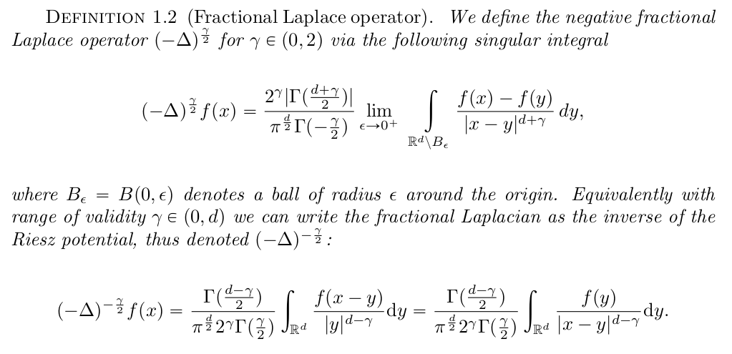
The Riesz potential and fractional Laplacians

Slide 12
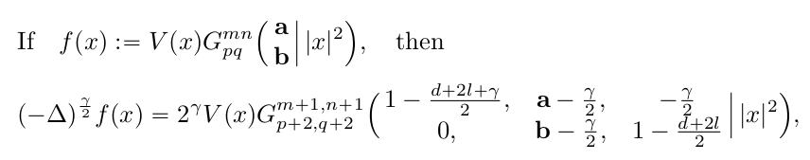
Motivation for using orthogonal polynomials
Dyda, B., Kuznetsov, A. & Kwaśnicki, M. Fractional Laplace Operator and Meijer G-function. Constr. Approx. 45, 427–448 (2017).

Slide 13
Motivation for using orthogonal polynomials
Dyda, B., Kuznetsov, A. & Kwaśnicki, M. Fractional Laplace Operator and Meijer G-function. Constr. Approx. 45, 427–448 (2017).
Kwaśnicki, Mateusz. Ten equivalent definitions of the fractional Laplace operator Fractional Calculus and Applied Analysis, vol. 20, no. 1, pp. 7-51 (2017).

Slide 14
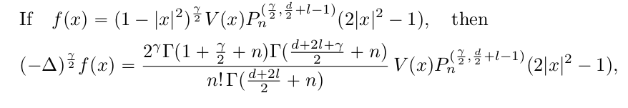
Motivation for using orthogonal polynomials
Dyda, B., Kuznetsov, A. & Kwaśnicki, M. Fractional Laplace Operator and Meijer G-function. Constr. Approx. 45, 427–448 (2017).
Kwaśnicki, Mateusz. Ten equivalent definitions of the fractional Laplace operator Fractional Calculus and Applied Analysis, vol. 20, no. 1, pp. 7-51 (2017).

Slide 15
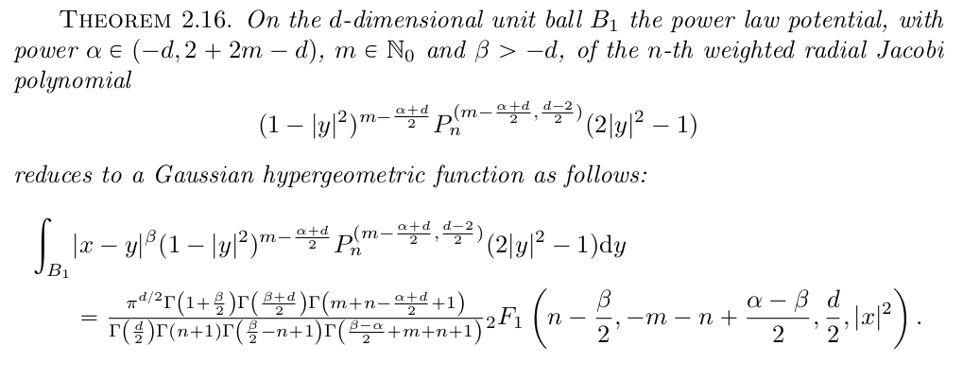
Jacobi polynomials and Riesz potentials

Slide 16
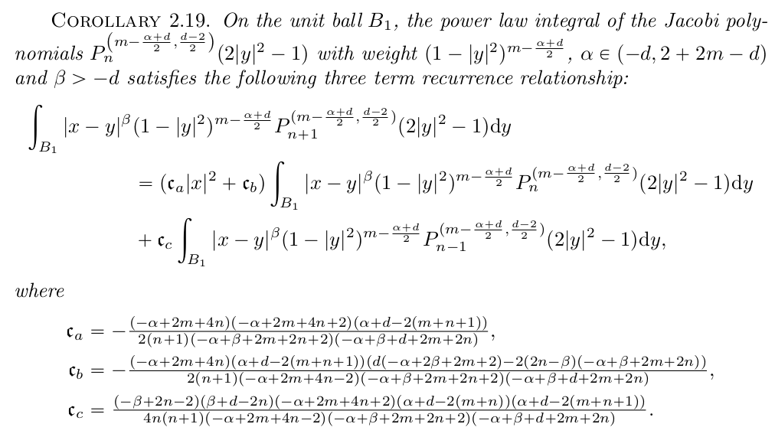
Jacobi-Riesz recurrence relationship

Slide 17
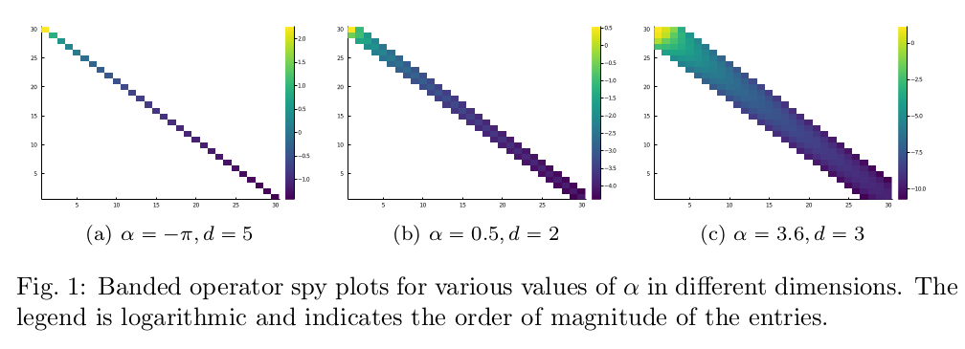
Banded structure of the Riesz potential operator

Slide 18
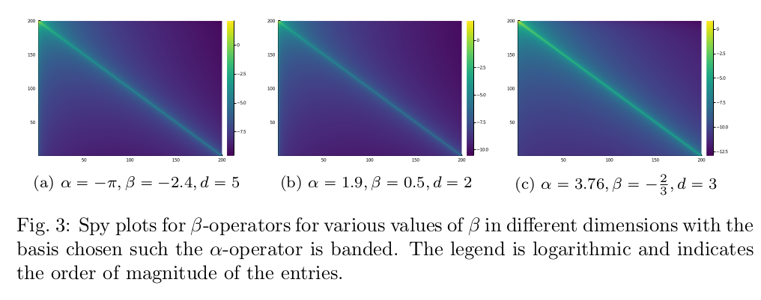
Banded structure of the Riesz potential operator

Slide 19
Part III: Numerical experiments and results

Slide 20
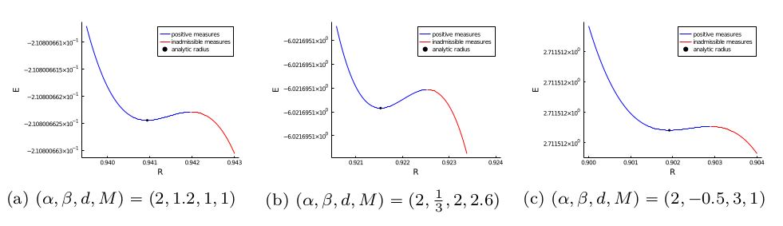
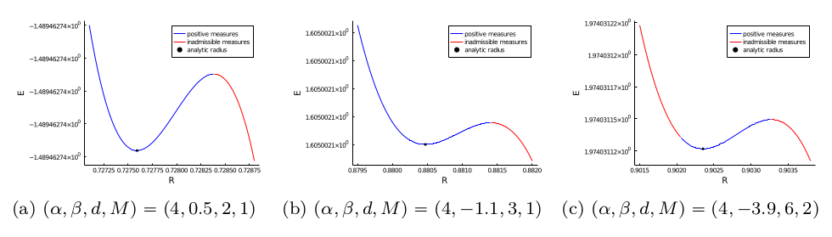
Reproducing known results

Slide 21
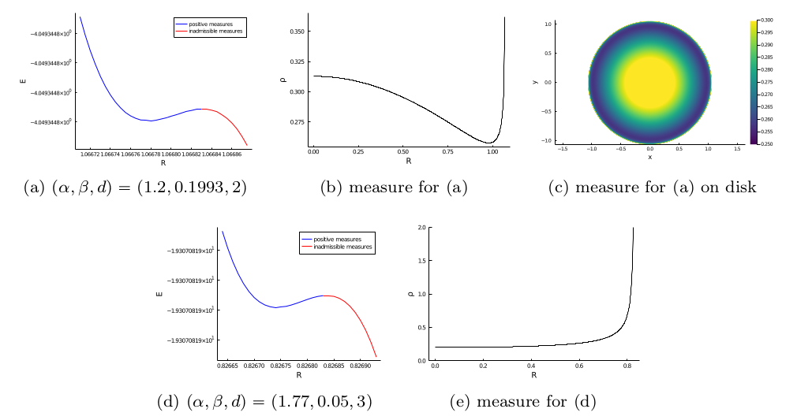
Unique minimizers away from analytic results

Slide 22
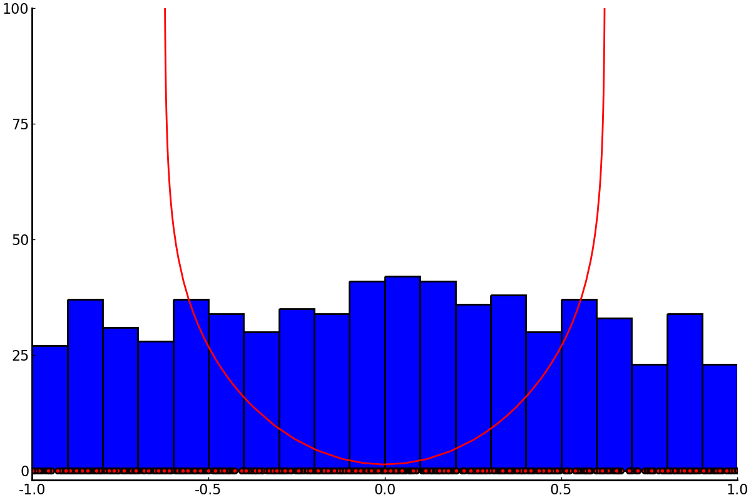
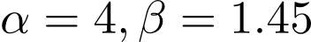
Comparison with discrete particle simulations

Slide 23
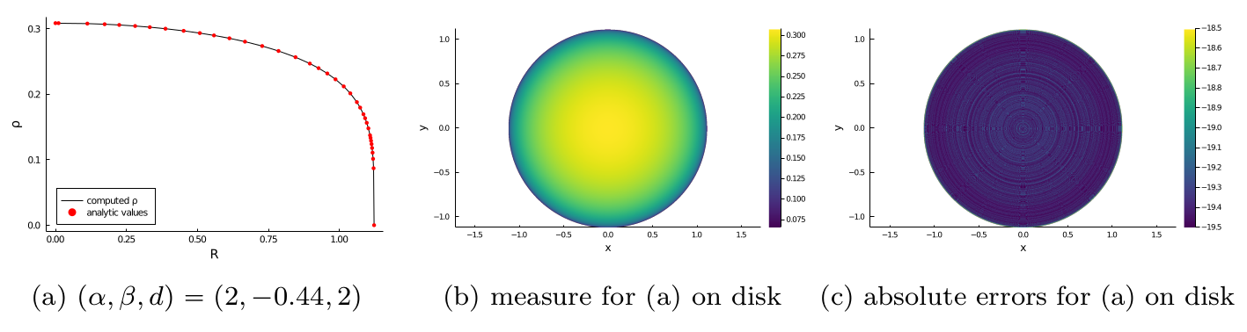
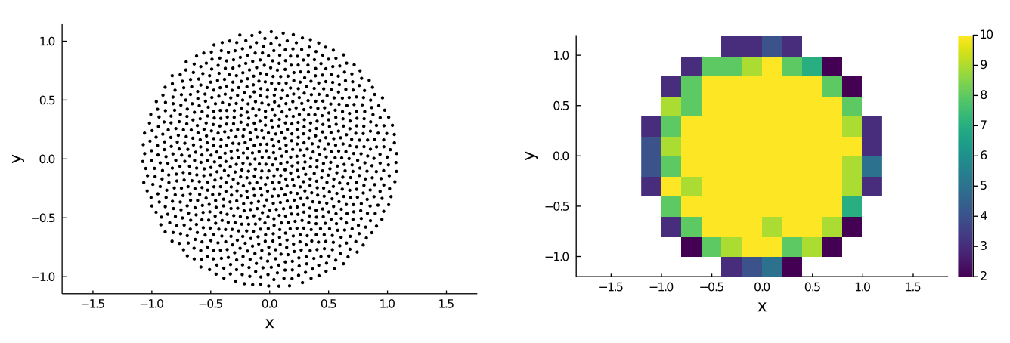
Some higher dimensional examples
Some higher dimensional examples

Slide 24
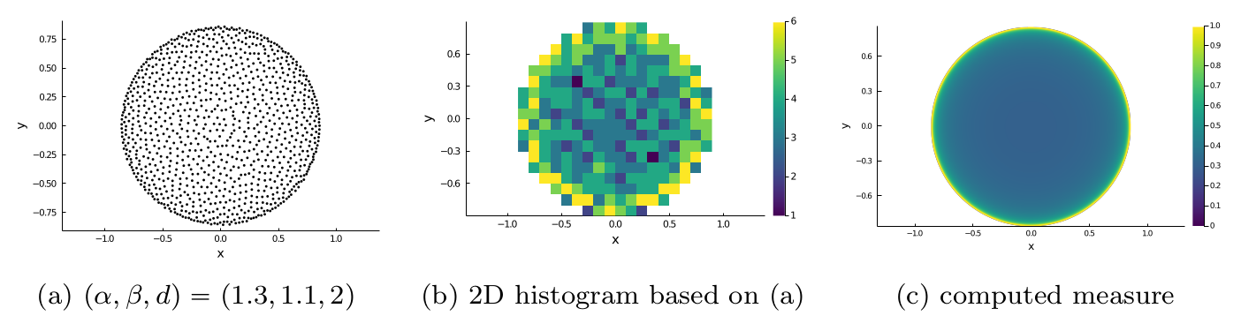
Some higher dimensional examples
Some higher dimensional examples

Slide 25
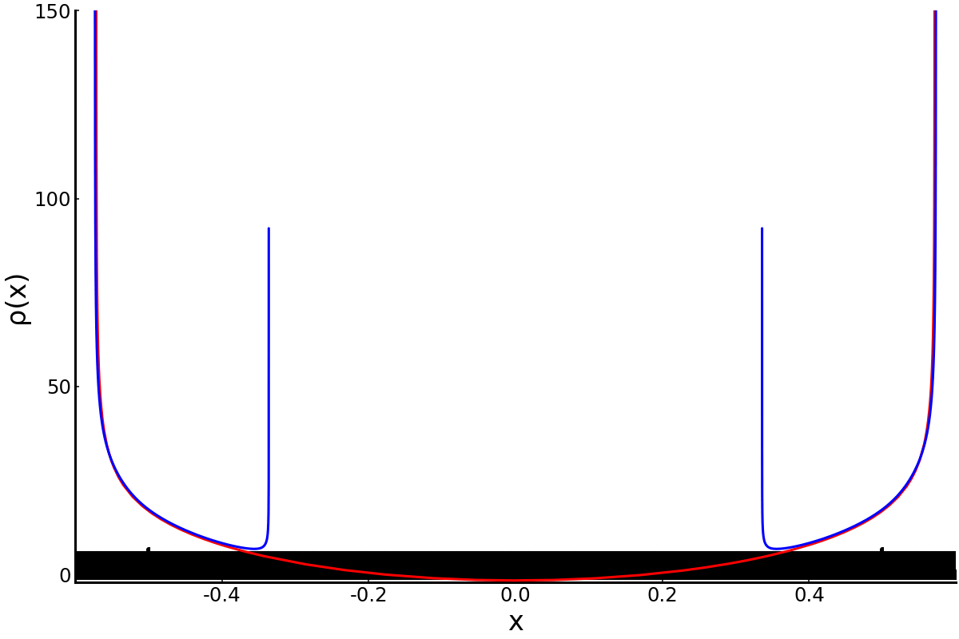
Gap formation for high repulsion

Slide 26
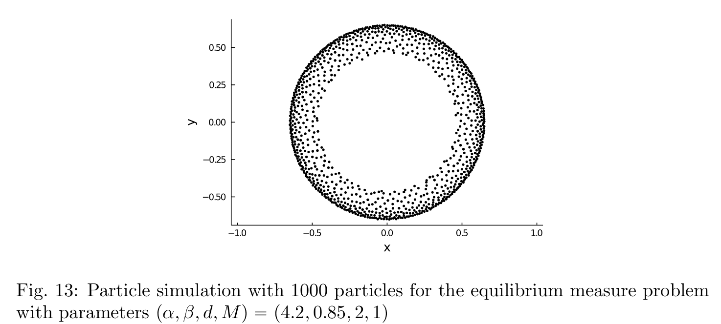
Spherical shells / annuli in higher dimensions?

Slide 27
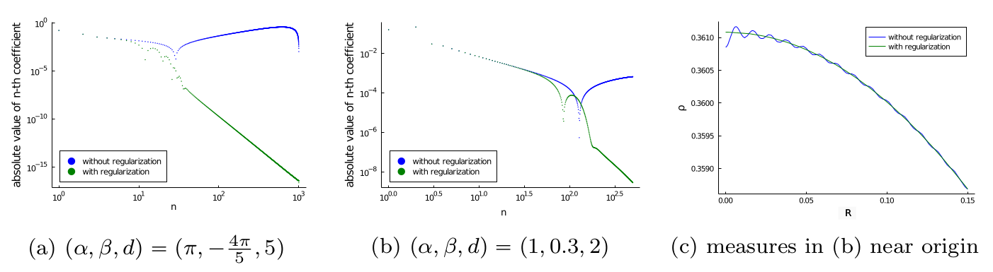
Convergence and stability
Remember we wish to minimize the expression

Slide 28
Thank you
Gutleb, T. S., Carrillo, J. A., & Olver, S. (2020). Computing Equilibrium Measures with Power Law Kernels. arXiv preprint arXiv:2011.00045.

